Slide 1
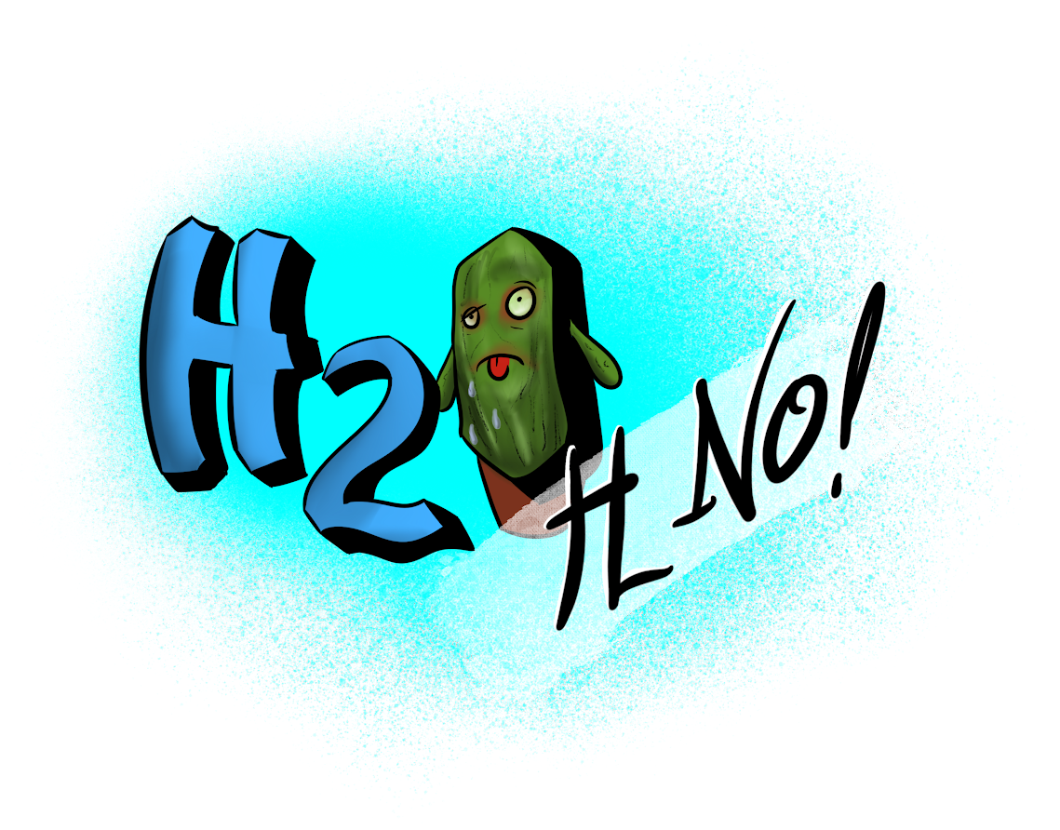
Team Comet
Nick Largey, Stephen Lanna, Eliza Cole

Slide 2
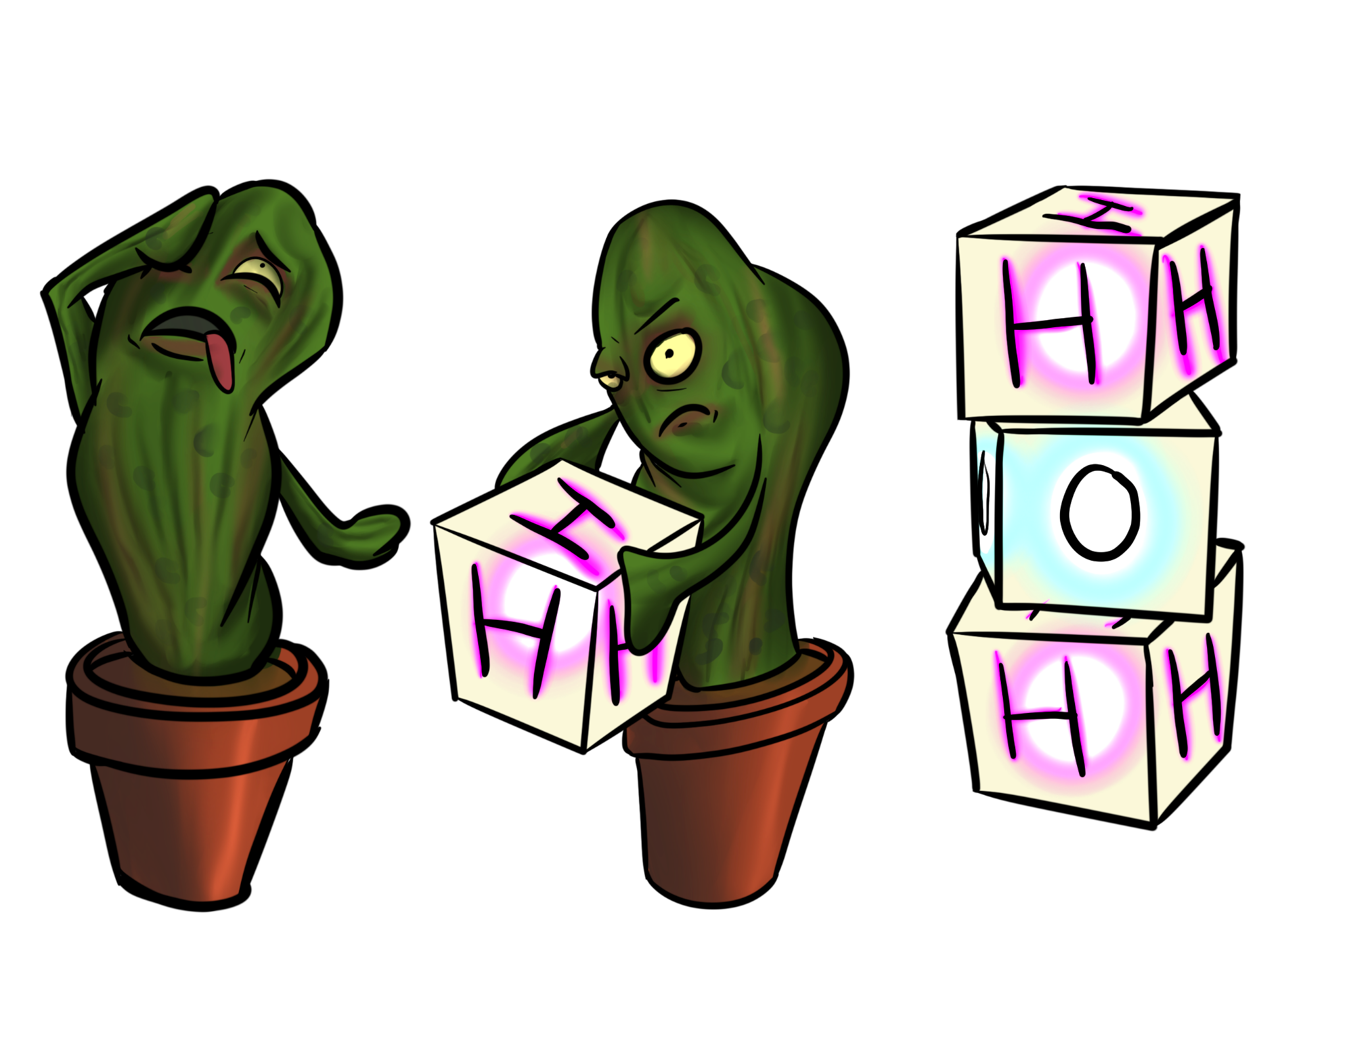
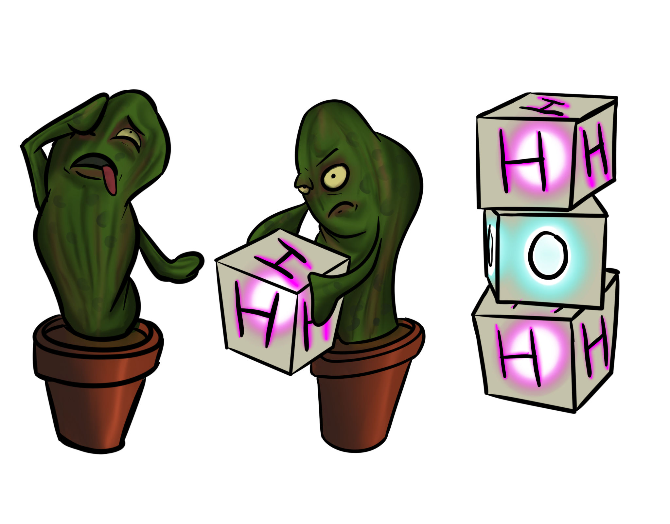
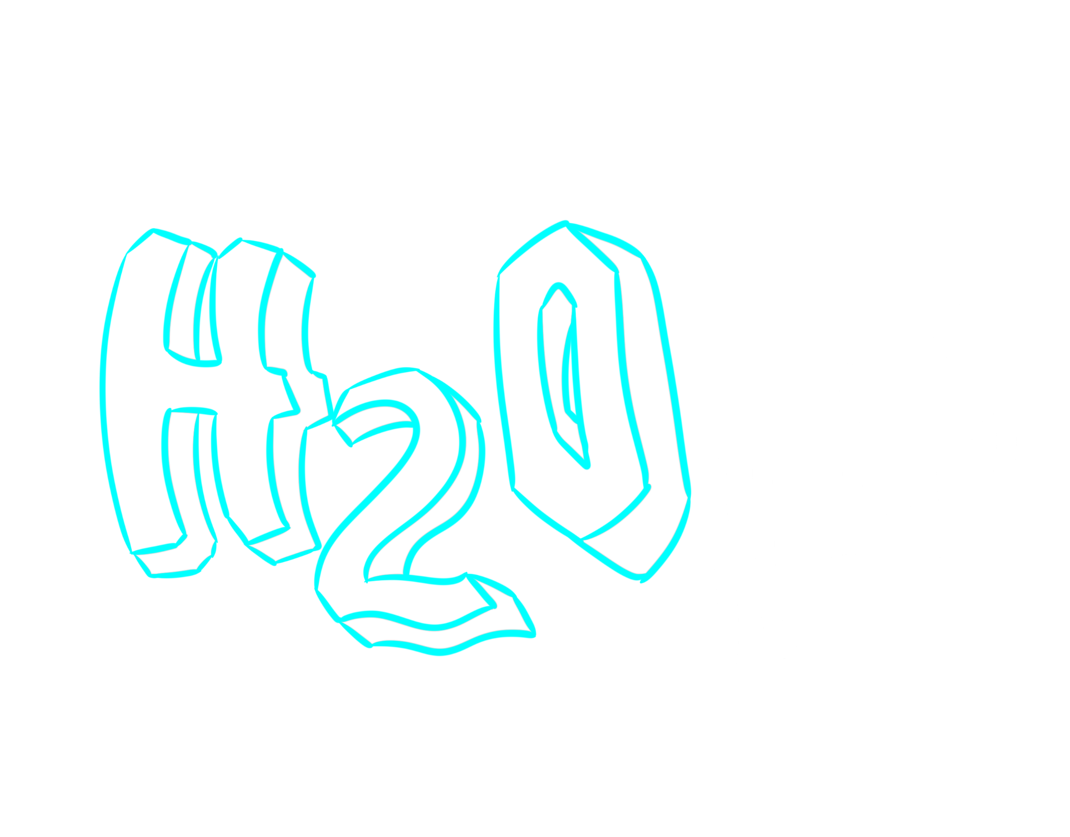
Premise
Location: Space Station
Character: Cactus
Objective: Collect cubes to make water
from two hydrogen atoms and one
oxygen atom

Slide 3
How to Play
Move with arrow keys or AWSD keys
Pick up items with E button
Drop items with space bar
If you drop two hydrogen on top of one oxygen, you make water!
Congrats! You didn’t die from dehydration
Notes:
Gamification: achievements/completion, social comparison, fun mechanics Why gamification works: brain chemicals and habit forming

Slide 4
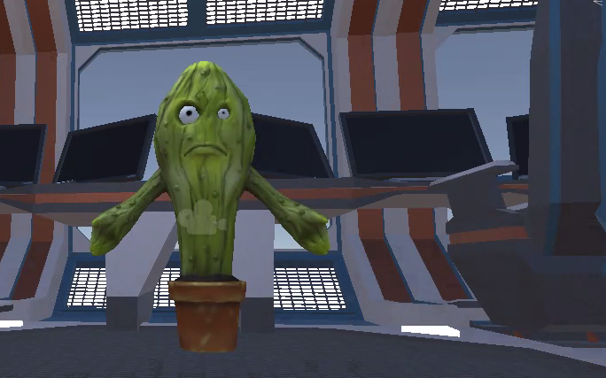
Demo

Slide 5

Programming Concepts
Prefab
Scene - Outpost with Snow
Character - Cactus
Plugin - Zibra Liquids
Creating game object in Unity
3D Object
Applying PNG image to the surface
Coding Scripts in C#
Rotate camera to character (Input.GetKeyDown, GetComponent<Camera>, transform.rotation)
Picking up objects (setting hand reference, setting rigid bodies and colliders, tagging objects)
Letting objects land (using GetComponent<Rigidbody>().isKinematic)
Destroying objects (OnTriggerEnter(Collider), Zibra Liquids)
Notes:
Future applications: more elements

Slide 6
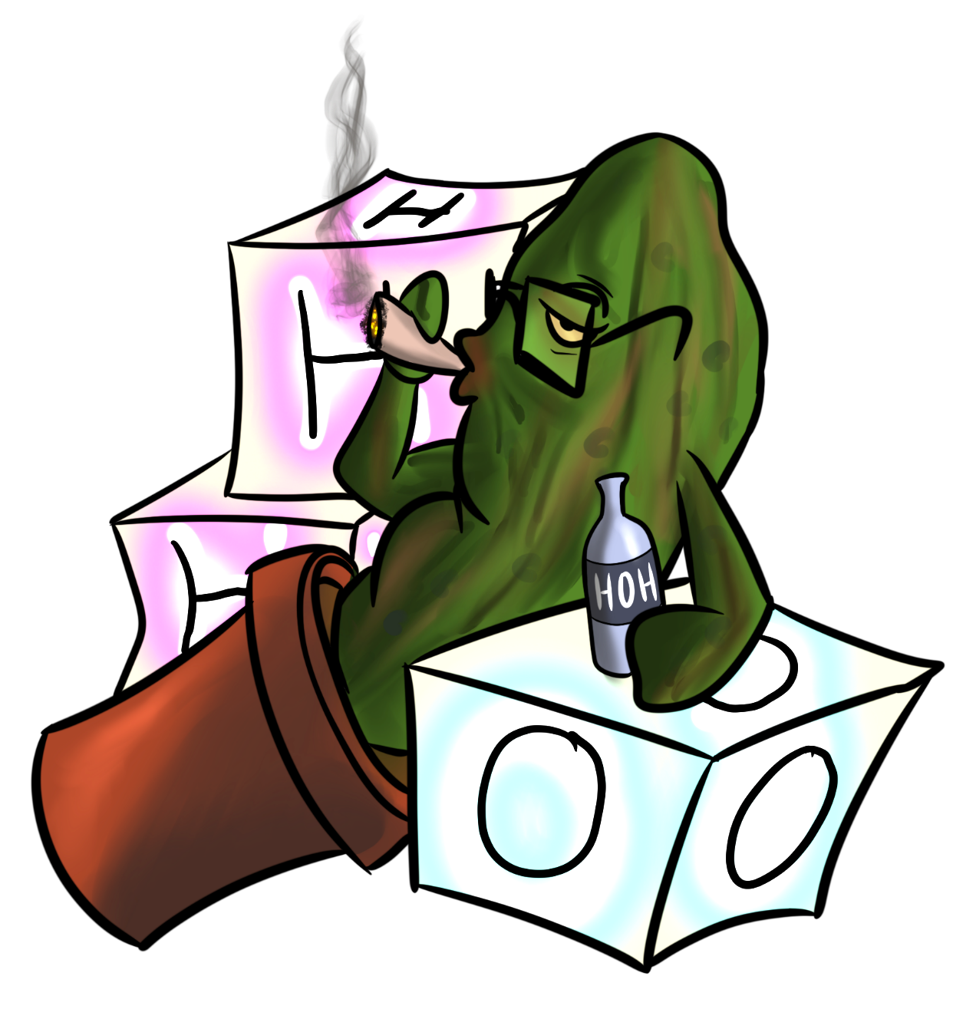
Questions?

